Slide 1
CAPSTONE PROJECT
SPAM MAIL DETECTION
Presented By:
1. BARANITHARAN R - CARE College of Engineering - Mechanical Engineering

Slide 2
OUTLINE
Problem Statement
Proposed System/Solution
System Development Approach
Algorithm & Deployment
Result
Conclusion
Future Scope
References

Slide 3
PROBLEM STATEMENT
Detecting the spam mail, With the exponential growth of email communication, the issue of spam mail has become increasingly prevalent, causing inconvenience and potential security risks for users. Spam mail, characterized by unsolicited and often malicious content, poses significant challenges for email service providers and users alike. Traditional rule-based spam filters are limited in their effectiveness, prompting the need for more advanced techniques leveraging machine learning and natural language processing.

Slide 4
PROPOSED SOLUTION
Data Collection:
-A large dataset of labeled emails, where each email is marked as spam or non-spam.
Model Selection and Training:
-A suitable machine learning algorithm Split the dataset into training and testing sets. Train the chosen model on the training data.
Model Evaluation:
-Evaluate the trained model's performance using metrics such as accuracy, precision, recall, and F1-score on the test dataset. Use techniques like cross-validation to ensure the model's generalizability.
Integration and Deployment:
-Integrate the trained model into an email service or spam filtering system to automatically classify incoming emails as spam or non-spam. Regularly update the model with new data to adapt to evolving spam patterns.

Slide 5
SYSTEM APPROACH
A system approach for spam mail detection involves considering various components and their interactions to create an effective spam filtering system.
Software requirements:
Programming Language:
-Python: Widely used for its extensive libraries in machine learning, natural language processing, and data analysis
Data Visualization:
-Matplotlib or Seaborn: For creating visualizations to analyze data distribution and model performance.
Version Control:
-Git: For version control and collaboration on code development
Documentation and Collaboration:
-GitHub or GitLab: For hosting code repositories and collaboration.

Slide 6
Hardware requirements: Processor (CPU): -Multi-core processors: Spam detection often involves processing large amounts of data in parallel Having multiple CPU cores can significantly improve performance during training and inference. Memory (RAM): -Sufficient RAM is essential for storing and manipulating datasets in memory, especially when using large-scale machine learning algorithms or processing large volumes of emails. Library requirement: Natural Language Processing (NLP): NLTK (Natural Language Toolkit)- A comprehensive library for natural language processing tasks such as tokenization, stemming, lemmatization, part-of-speech tagging, and named entity recognition. Feature Extraction and Vectorization: Scikit-learn-A popular machine learning library that includes various algorithms for classification, regression, clustering, and preprocessing Data Visualization: Matplotlib- A versatile library for creating static, interactive, and animated visualizations in Python.
SYSTEM APPROACH- CONT.

Slide 7
ALGORITHM & DEPLOYMENT
ALGORITHEM SELECTION
Naive Bayes:
-Naive Bayes classifiers are simple yet effective algorithms commonly used for text classification tasks like spam detection.
Support Vector Machines (SVM):
-SVMs are powerful algorithms for binary classification tasks.
-They work well in high-dimensional spaces and are effective at separating data points using hyperplanes.
Random Forest:
-Random Forest is an ensemble learning method that builds multiple decision trees and combines their predictions.
-It is robust to overfitting and works well with both numerical and categorical data
Gradient Boosting Machines (GBM):
-GBM is another ensemble learning technique that builds a sequence of decision trees.

Slide 8

TRAINING PROCESS Data Collection: -A diverse dataset of emails labeled as spam or non-spam (ham). -The dataset is representative of the types of emails the system will encounter in production. Model Selection and Training: -Choose an appropriate machine learning algorithm for classification (e.g., Naive Bayes, Support Vector Machines, Random Forest, etc.). -Split the dataset into training and testing sets. -Train the selected model on the training data using the extracted feature Model Evaluation: -Evaluate the trained model's performance using metrics such as accuracy, precision, recall, F1-score, and ROC curve on the test dataset. -Use techniques like cross-validation to ensure the model's generalizability.

Slide 9
DETECTION PROCESS Email Preprocessing: -When an email is received, preprocess the email content to make it suitable for analysis. classification: -Input the extracted features into the trained spam detection model. -The model will output a prediction indicating whether the email is spam or non-spam. Thresholding: -Apply a threshold to the predicted probabilities to determine the final classification. For example, if the predicted probability of an email being spam is above a certain threshold (e.g., 0.5), classify it as spam; otherwise, classify it as non-spam. Feedback Loop: -Collect feedback from users on the accuracy of the spam detection system. -Use user feedback to improve the model

Slide 10
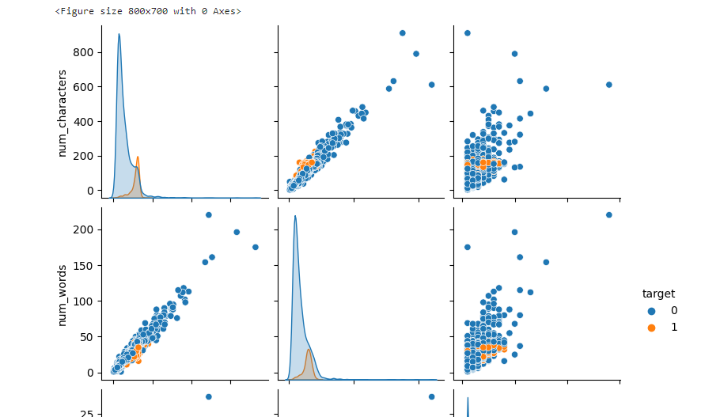
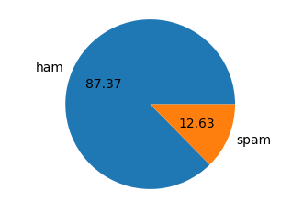
RESULT
DTA PROCESSING
Exploratory Data Analysis (EDA)

Slide 11

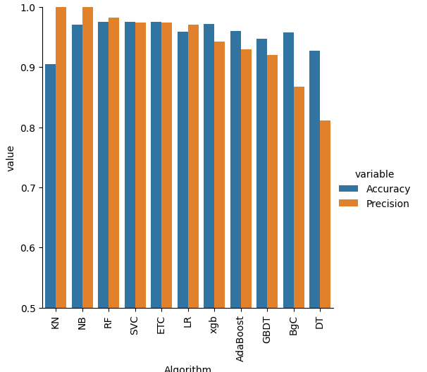
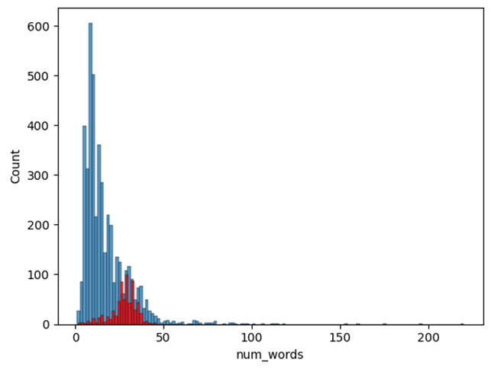
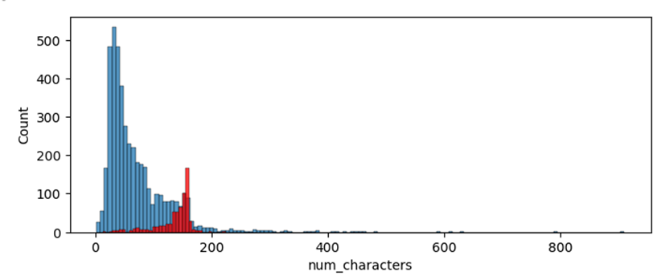
MODEL BUILD

Slide 12
CONCLUSION
In conclusion, building an effective spam mail detection system is crucial for safeguarding email users from unwanted and potentially harmful emails. Throughout this process, several key components and considerations Such as, Data Collection and Pre-processing, Algorithm Selection and Model Development, Integration and Deployment, Continuous Improvement and Monitoring, Exploratory Data Analysis (EDA).
This considerations, a spam mail detection system can effectively filter out unwanted emails while minimizing false positives and false negatives. However, it's important to recognize that spam tactics are constantly evolving, and the system must be continuously monitored, updated, and improved to stay effective in mitigating the impact of spam on email users.

Slide 13
FUTURE SCOPE
Advanced Machine Learning Techniques:
Exploration of deep learning architectures: Investigating the application of deep learning models, such as recurrent neural networks (RNNs) or transformers, for spam detection to capture more complex patterns in email content.
Natural Language Processing (NLP) Advancements:
Enhanced text representation techniques: Developing more sophisticated methods for representing email text, including contextual embeddings and attention mechanisms, to capture semantic relationships and context.
Behavioral Analysis:
User behavior modeling: Incorporating user interaction data, such as email open rates, click-through rates, and user feedback, to personalize and improve spam filtering based on individual preferences.
Cross-Platform Integration:
Integration with other communication platforms: Extending spam detection capabilities beyond email to other communication channels, such as messaging apps, social media platforms, and collaboration tools.

Slide 14
REFERENCES
Almeida, T. A., & Yamakami, A. (2010). Contributions to the study of SMS spam filtering: New collection and results. In Proceedings of the 2010 ACM Symposium on Applied Computing (pp. 1410-1414).
Forman, G., & Kirshenbaum, E. (2006). Detecting spam blogs: A machine learning approach. In Proceedings of the 2006 Conference on Email and Anti-Spam (CEAS).
Carreras, X., & Marquez, L. (2001). Boosting trees for anti-spam email filtering. In Proceedings of the Conference on Email and Anti-Spam (CEAS).
D. Dua and C. Graff, UCI machine learning repository, 2017. [Online]. Available: http://archive.ics.uci.edu/ml.
R. Hassanpour, E. Dogdu, R. Choupani, O. Goker, and N. Nazli, “Phishing e-mail detection by using deep learning algorithms,” in Proceedings of the ACMSE 2018 Conference, 2018, pp. 1–1.

Slide 15
THANK YOU

